Slide 1
Sprint 1
Teamoji
Backend of emoji checker app
Notes:
Our big picture goal is to host and manage the database and all other server-side processes with which the front-end and administration teams interact.
The product is the infrastructure that the app is built upon.

Slide 2
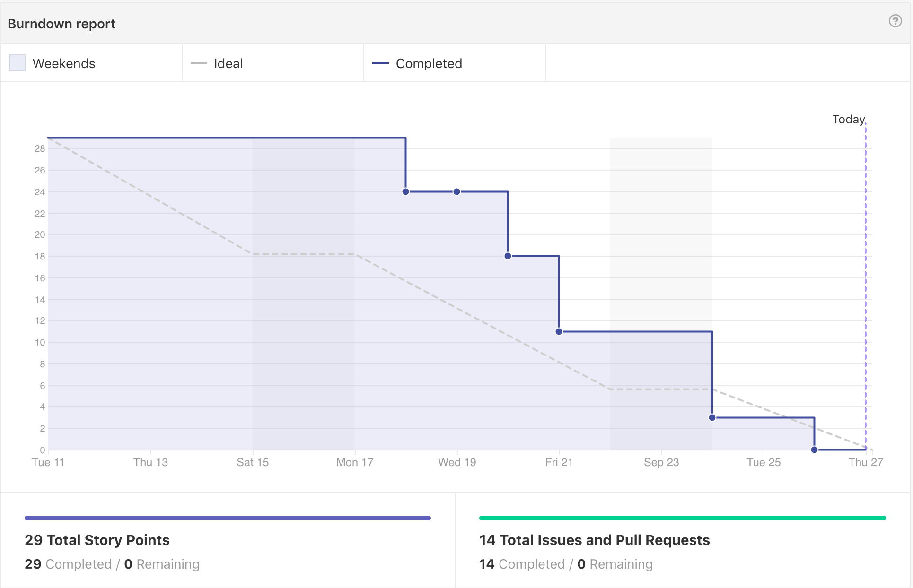
Burn down chart
Notes:
Stairs because stories are completed when the tasks are completed.
Steps could be smaller if stories are broken down in a certain way (more story points to larger stories).
We adapted the correct scope of the sprint backlog to complete the sprint, mostly research and infrastructure.
Discuss the reasons for late progress in the first half of the sprint and solve those issues.

Slide 3

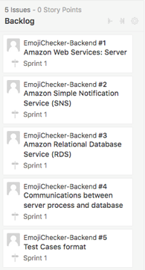
Completed story cards
Using Amazon EC2 instance to host scheduling daemon and Django server.
Using Amazon SNS for sending notifications to users.
Using RDS with MySQL to host and manage the database.
Cron job and Django REST framework.
Probably will not use Moto for testing purposes.
Notes:
Amazon EC2 is the virtual machine which will hold the cron job, Django web server, and any other server process.
SNS will be used to send users reminder texts to upload their emojis.
RDS is hosting the database and we will be interacting with it using MySQL and Django.
The database contains different tables such as users table, schedule table, response table, etc. That will be utilized by the other teams.
Cronjob will run a script every so often to check the schedule table. This will let us know whether its time to send out notifications to the users signed up for the app.
Django REST framework allows us to use an ORM, which makes managing items in the database with MySQL easier. This framework can be used across all the teams.
We are still considering whether or not to use Moto (which can be used for testing without the real EC2, RDS, and SNS instance).

Slide 4

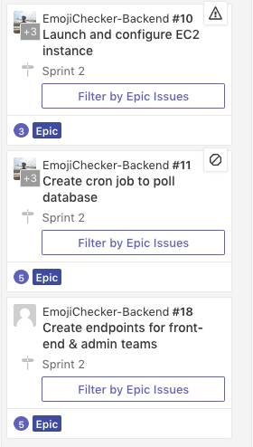
Backlog stories
Get our EC2 instance up and running.
Create a cron job that runs a script to query against the schedule table in the database.
Endpoints will be utilized by the other teams via HTTP so they can upload/receive information.

Slide 5
Risks found so far
We may have underestimated the complexity of the story cards.
Story cards may need to be pushed to second sprint, such as those that ask for implementation.
Confusion between how data is going to be handled between the different groups.

Slide 6
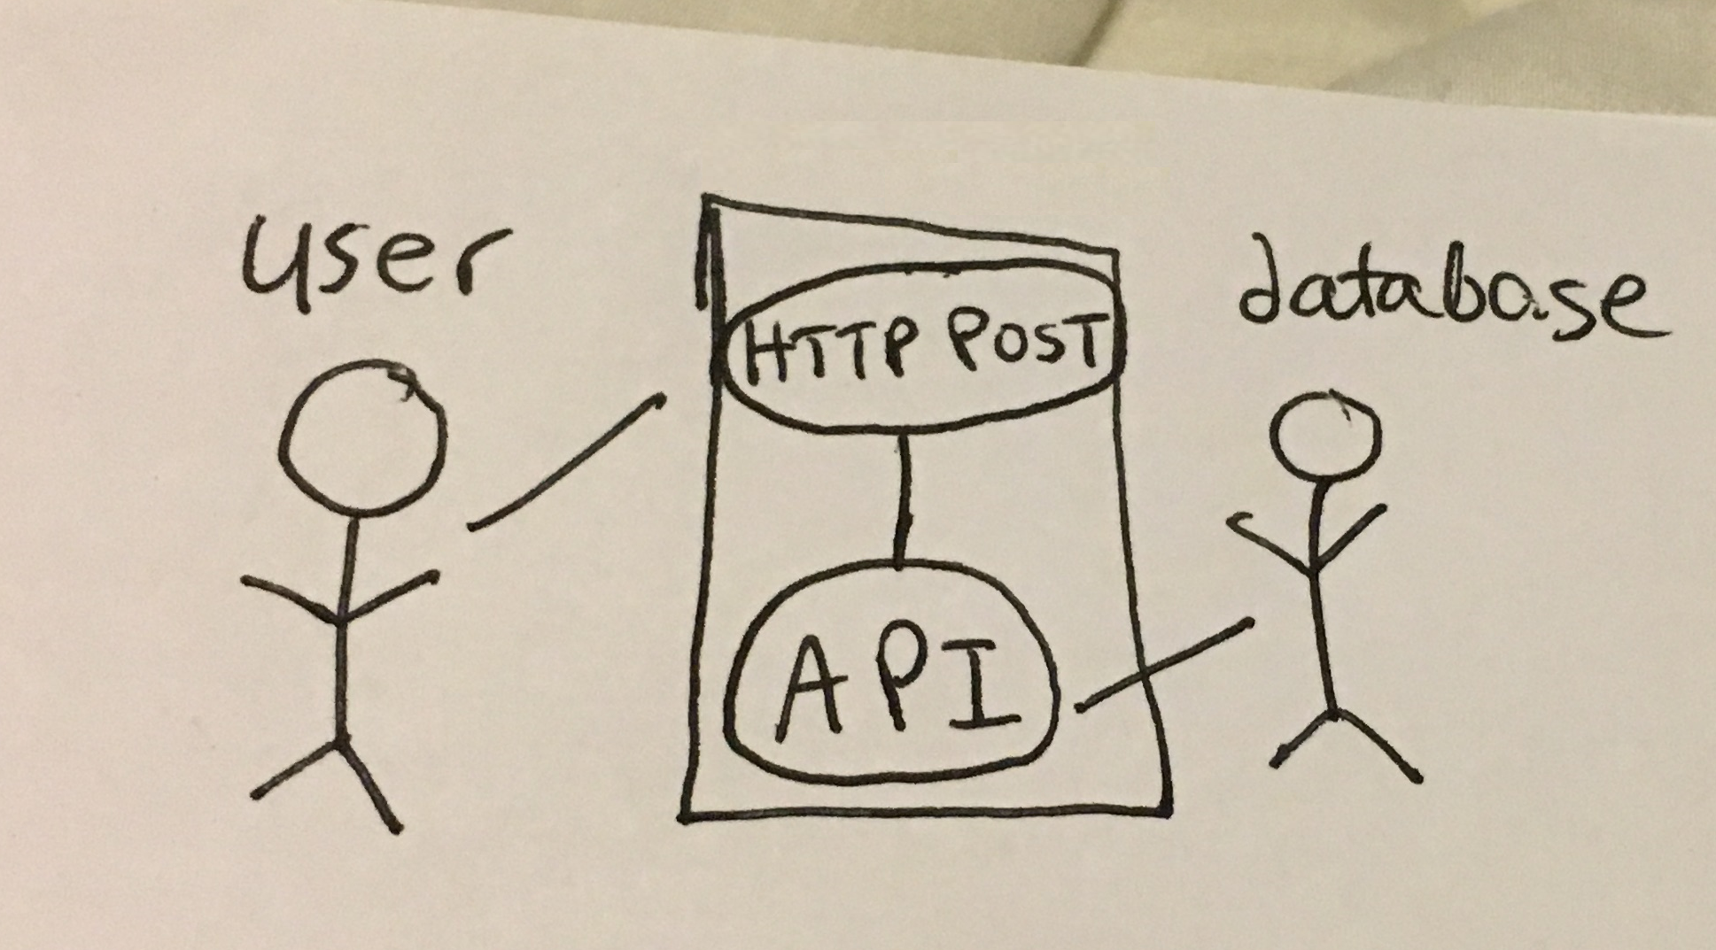
Use case diagrams
Notes:
User signing up and creating their user profile from the app

Slide 7
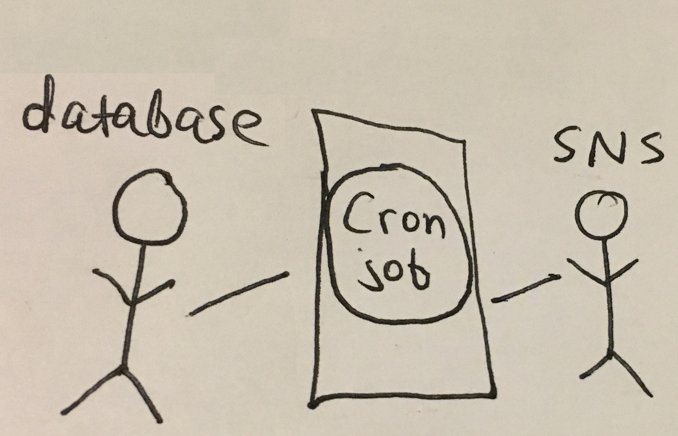
Use case diagrams
Notes:
Cron job checking for new notifications to be sent out

Slide 8
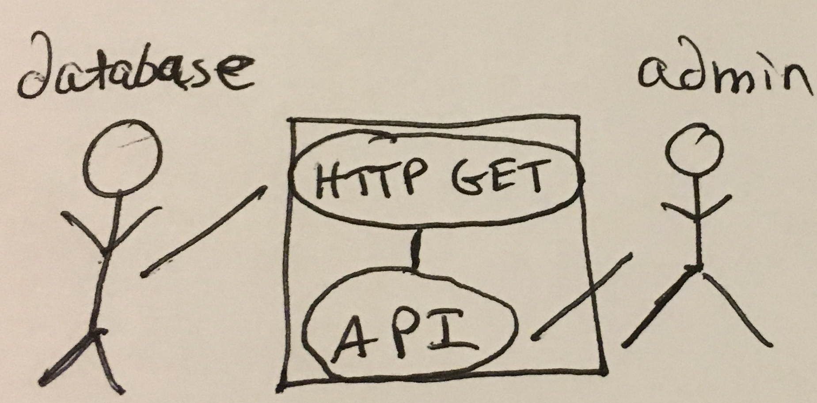
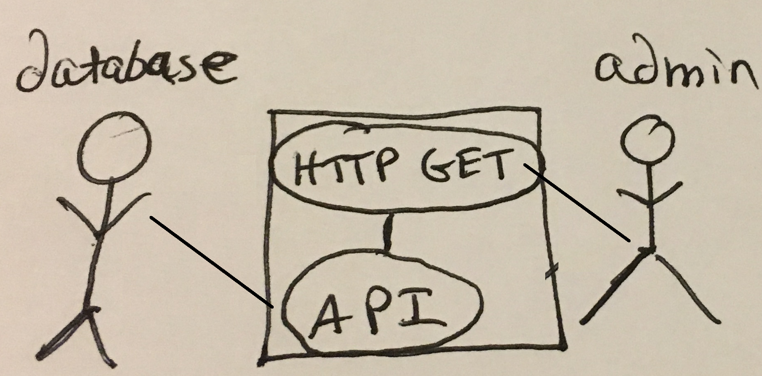
Use case diagrams
Notes:
Administrator retrieving list of users from the database

Slide 9
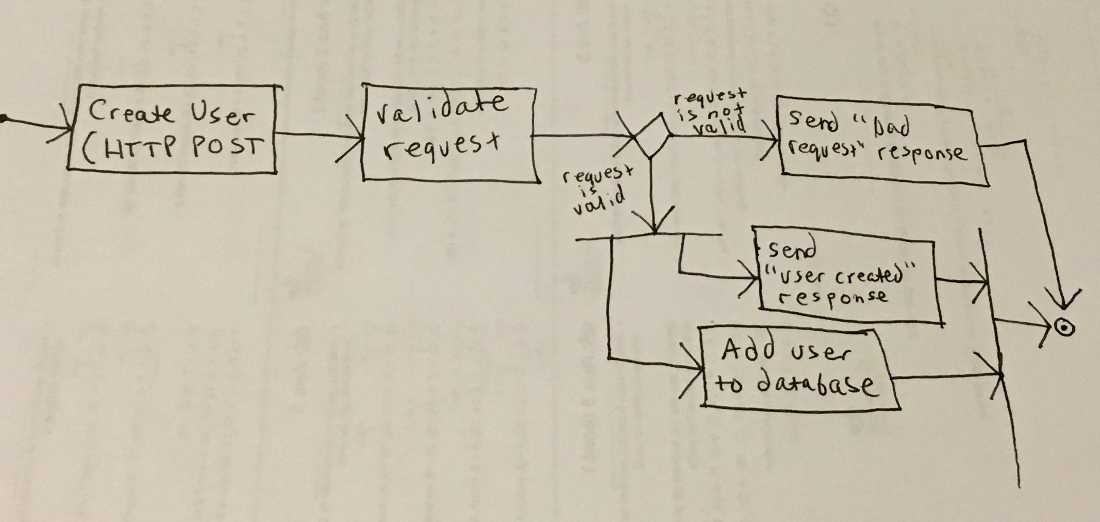
State diagrams
Notes:
Validate request: checks if user or phone number already exists, correct phone number / date format, if password is "too common"

Slide 10
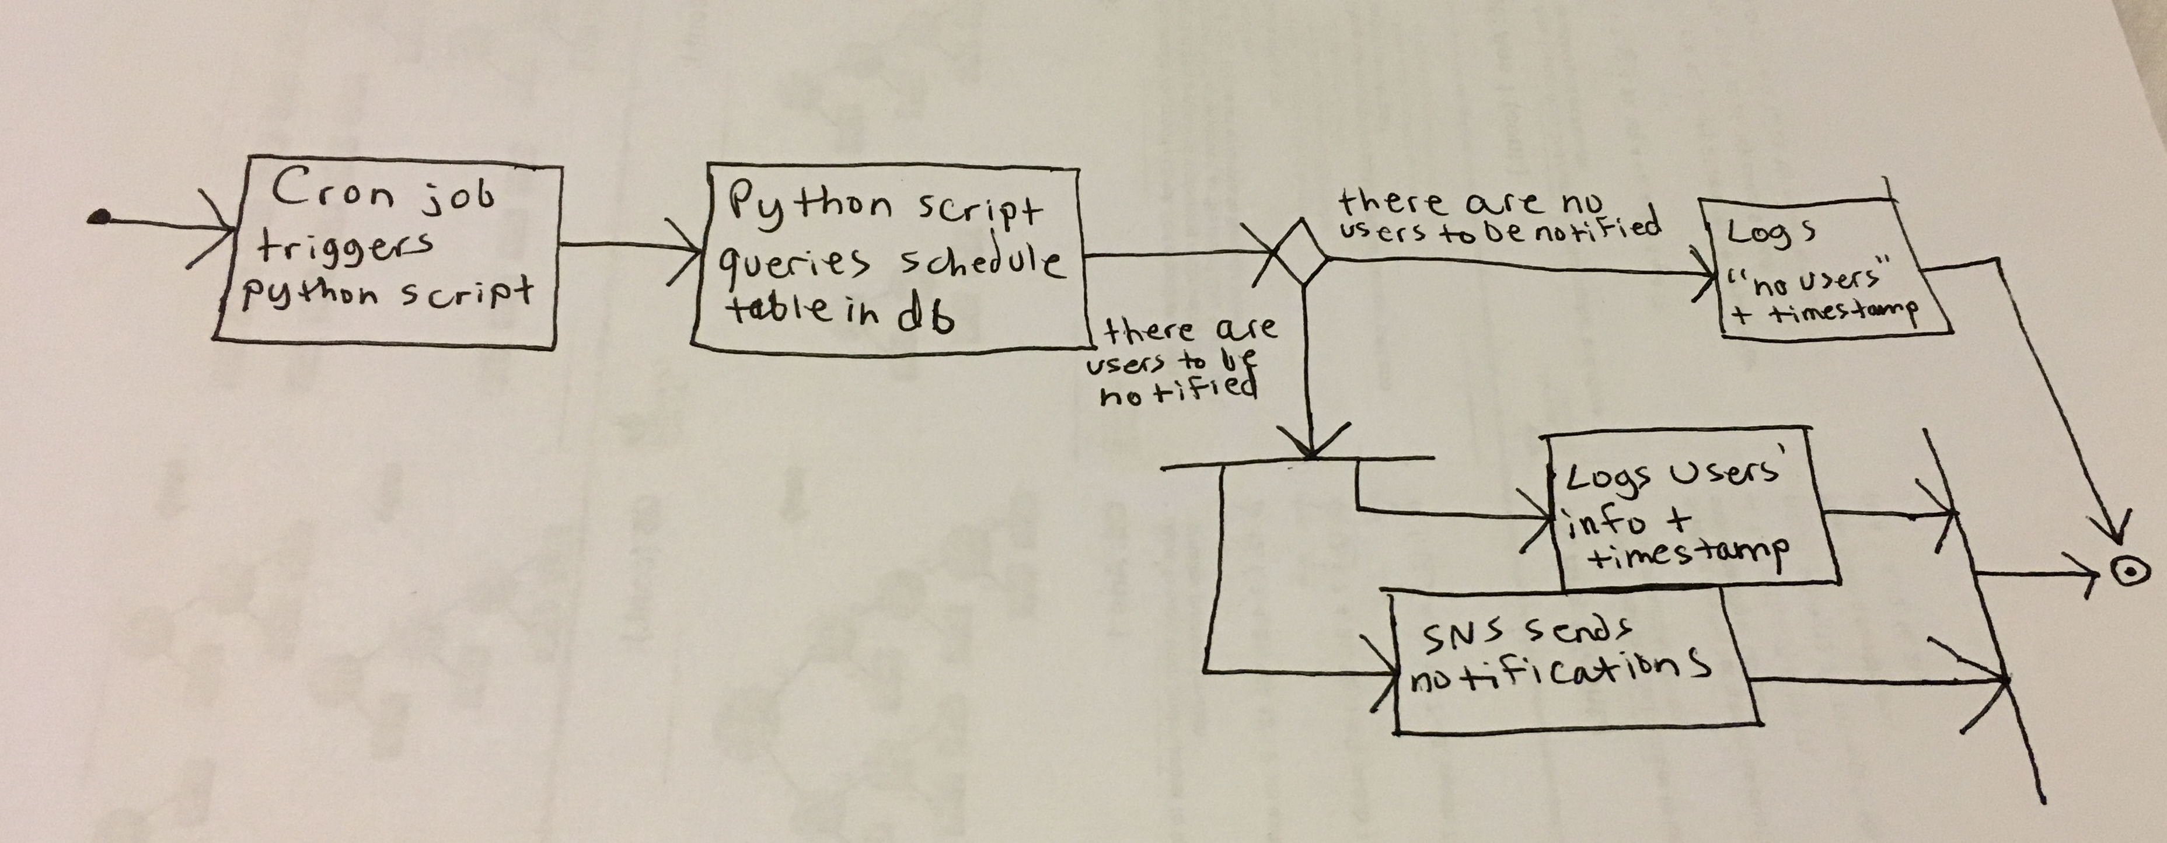
State diagrams
Notes:
Logs are useful because if something goes wrong we want to be able to look back and see a record of exactly what's happening and when

Slide 11
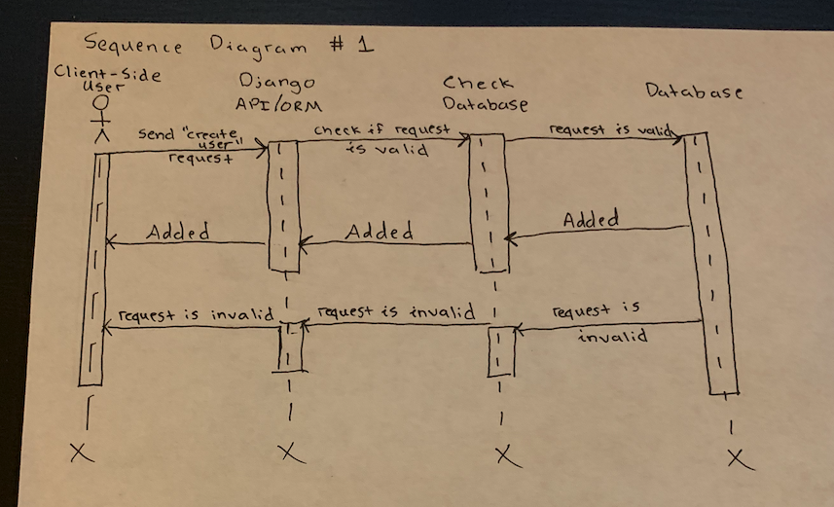
Sequence diagrams

Slide 12
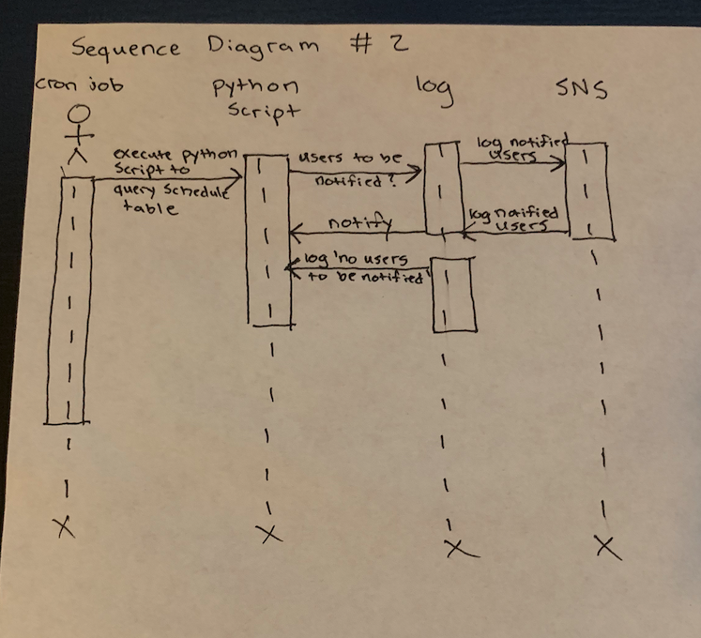
Sequence diagrams

